Slide 1
Setting up a React Environment
Revised: August 26th 2019

Slide 2
Setting Up an Environment
create-react-app
Zero-config (at first)
Has everything you need to get started
It can be hard to tell how your app works
You likely will have to configure something eventually and will have to “eject” your create-react-app. You won’t like it.
From Scratch
Takes some setup and config
Might have to worry about some polyfills down the road
Less unnecessary overhead
Easier to troubleshoot
No magic, you will know what’s doing what

Slide 3
React from Scratch - Dependencies
React
react
react-dom
react-hot-loader (optional)
Babel
@babel/core
@babel/cli
@babel/preset-env (ES6+ support)
@babel/preset-react (JSX support)
Webpack
webpack
webpack-cli
webpack-dev-server
babel-loader
css-loader
style-loader

Slide 4
React App from Scratch – Project Initialization
$ mkdir scratch-app
$ cd scratch-app
Make a folder
Initialize a node project
Follow the prompts to setup package.json details (defaults are okay):
$ npm init
{
"name": "scratch-app",
"version": "1.0.0",
"description": "React Template",
"main": "index.js",
"scripts": {
"test": "echo \"Error: no test specified\" && exit 1"
},
"author": "Jeff Barras",
"license": "ISC"
}
package name: (scratch-app)
version: (1.0.0)
description: React Template
entry point: (index.js)
test command:
git repository:
keywords:
author: Jeff Barras
license: (ISC)
Results in

Slide 5
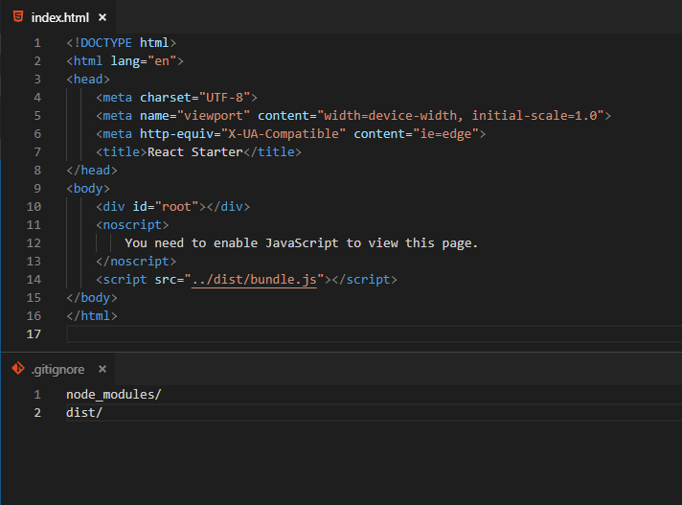
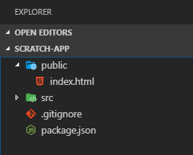
React App from Scratch – General Setup
At this point you have a project folder with package.json
It’s a good time to initialize git
And add a remote
Next we will add a .gitignore, folders and index.html – the only html we will need for a SPA!
$ git init
$ git remote add origin <repo address>
Remember this little guy. He’s important.

Slide 6
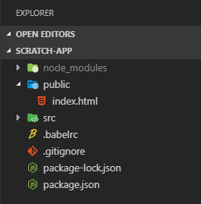
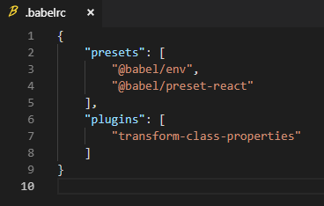
React App from Scratch – Babel
The browser will not run ES6 (usually) or JSX directly. We need to convert both to plain JavaScript. This is done through the use of a “transpiler” like Babel.
core and cli are involved in transpiling and watching for changes to development JS.
preset-env contains settings for transpiling ES6+ JS.
preset-react contains settings for transpiling JSX.
Babel-plugin…class-properties allows us to use instance variables outside of the constructor.
Install babel core and presets
Create .babelrc at project root
$ npm i –-save-dev @babel/core @babel/cli @babel/preset-env @babel/preset-react babel-plugin-transform-class-properties

Slide 7
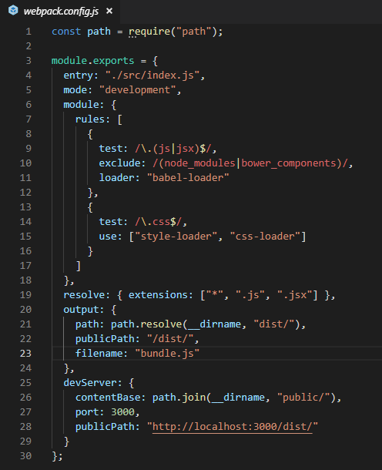
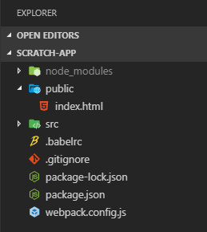
React App from Scratch – Webpack
Webpack is a module bundler.
Walks dependency tree and outputs bundle.js
Install webpack, dev server, and loaders
Create webpack.config.js at project root
$ npm i save-dev webpack webpack-cli webpack-dev-server style-loader css-loader babel-loader
Notes:
We will import and export components and other modules throughout our application. Webpack walks through these dependencies and “bundles” them in the order they’re needed and leaves things out of our bundle that we don’t use. It also has other functions built in, and even more that we can plug in for minification, style loading, media loading, etc.
Lot of stuff here, but basically there are three things happening:
- `webpack` and `webpack-cli` - The core components of webpack necessary for webpack to do anything.
- `*-loader` - webpack is separated into individual loaders so you only have to pull in what you need. Here we are loading babel and styles so that they can be bundled.
- `webpack-dev-server` - a development server that runs the app and updates on save.

Slide 8
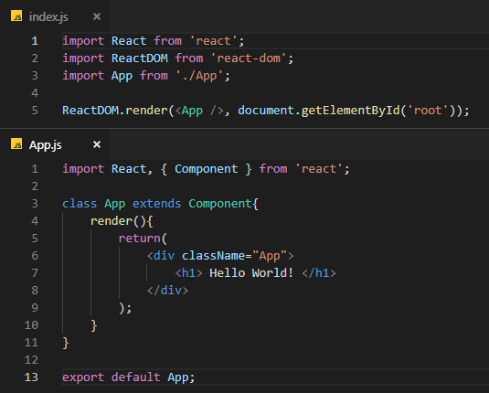
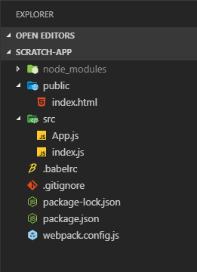
React App from Scratch – React
Now to add a React application shell
Install React and ReactDOM
Create the following in src
index.js – entry point
App.js – root component
$ npm i react react-dom

Slide 9
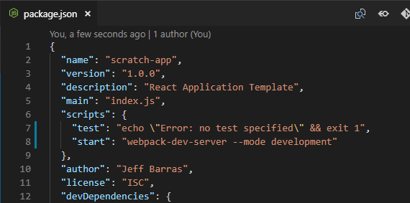
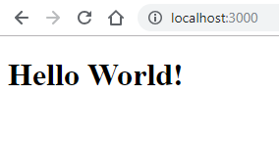
React App from Scratch – Finish up
That’s all we really need for our boilerplate. The app is ready to run. We will add a start script to our package.json to make it easier.
1.
2.
3.
$ npm start

Slide 10
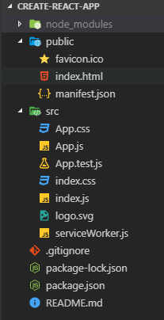


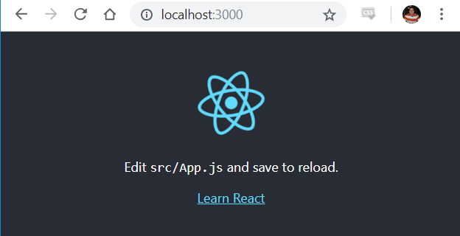

Using create-react-app
To initialize a new app run the command:
Make ‘app-name’ whatever you want.
You will be provided a folder structure that looks like this.
App.js is your entry-point, or “root component”
$ npx create-react-app app-name
To run your app:
Will host your application at ‘localhost:3000’
$ npm start

